Slide 1
Developing Database Applications
Connecting to a Database from An Application
Prof Dr Melike Şah Direkoğlu

Slide 2
Outline
Connecting from PhP to a database
Connecting from Java to a database
Connecting from C languages to a database

Slide 3
Connection from PhP to DB

Slide 4
Connecting PHP to MySQL using WAMP
On windows, you can download and install WAMP. With one installation and you get an Apache webserver, database server and php.
http://www.wampserver.com
On mac, you can download and install MAMP.
http://www.mamp.info/en/index.html

Slide 5
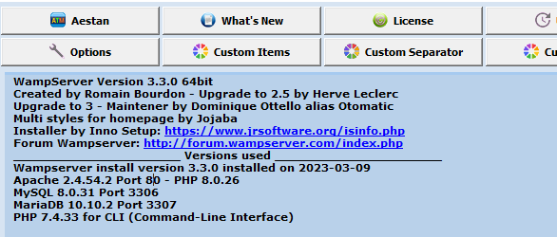
First Start Wamp and Apache Servers

Slide 6
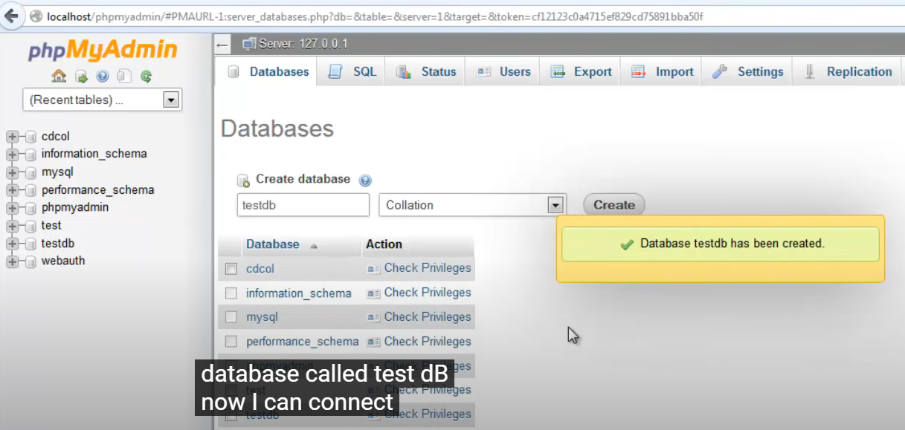
First Create a New Database using PhpMyAdmin

Slide 7
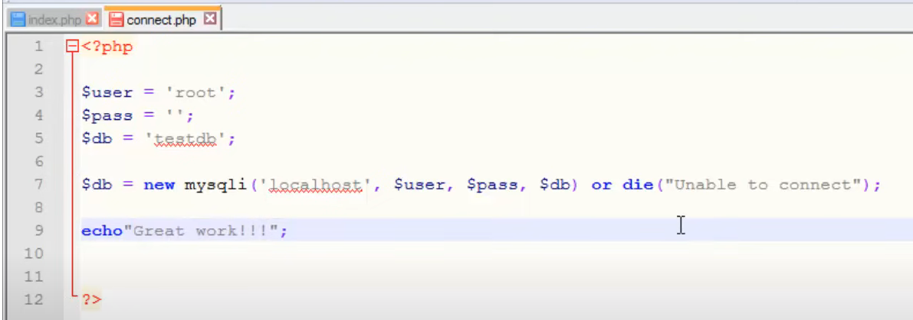
Write PhP Connection Code

Slide 8

Check whether connection works

Slide 9
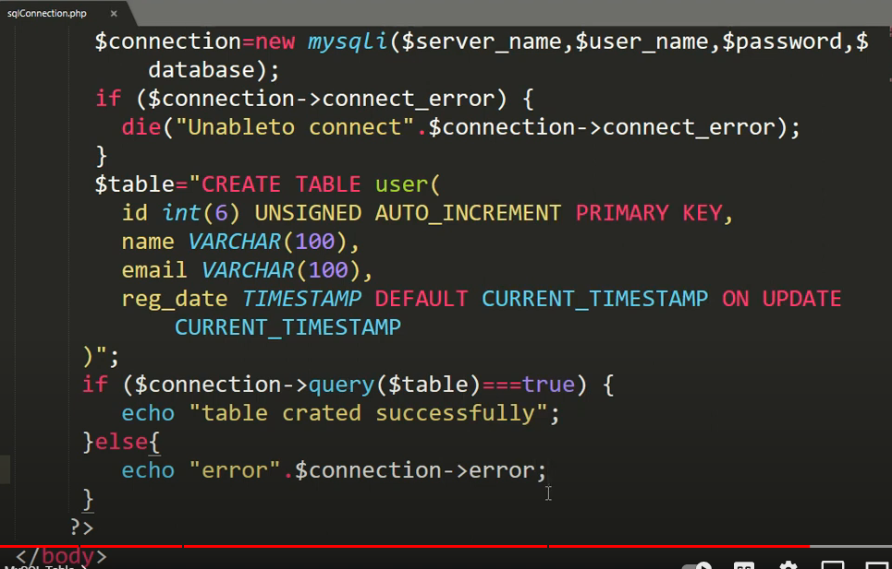
Sending SQL queries to the Database

Slide 10



Slide 11
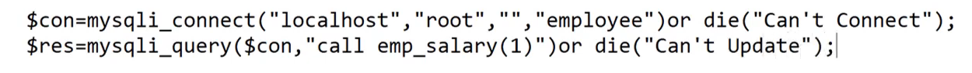
Calling a Procedure from PhP
emp_salary is the procedure name.
First create the procedure using PhPMyadmin interface or SQL command.
Then, call it from the body of PhP code as follows.

Slide 12
Connection from Java to a DB using JDBC Connector

Slide 13
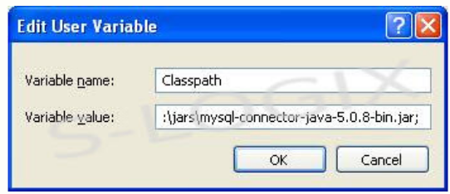
First download JDBC Connector and then Add JDBC connector path to the classpath

Slide 14
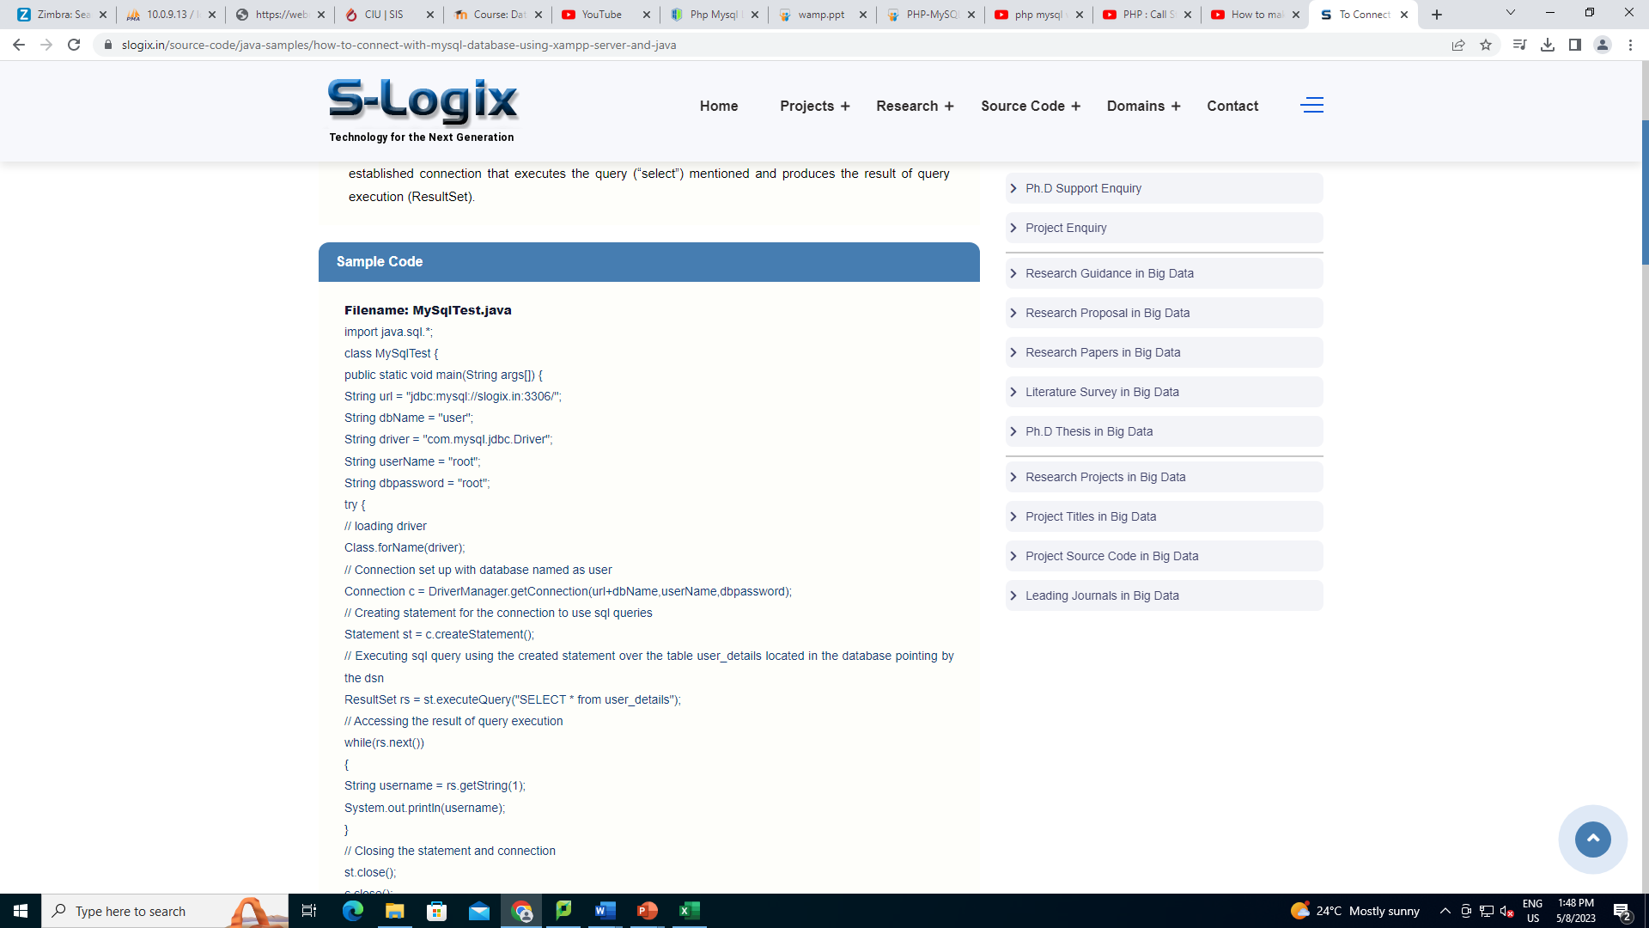
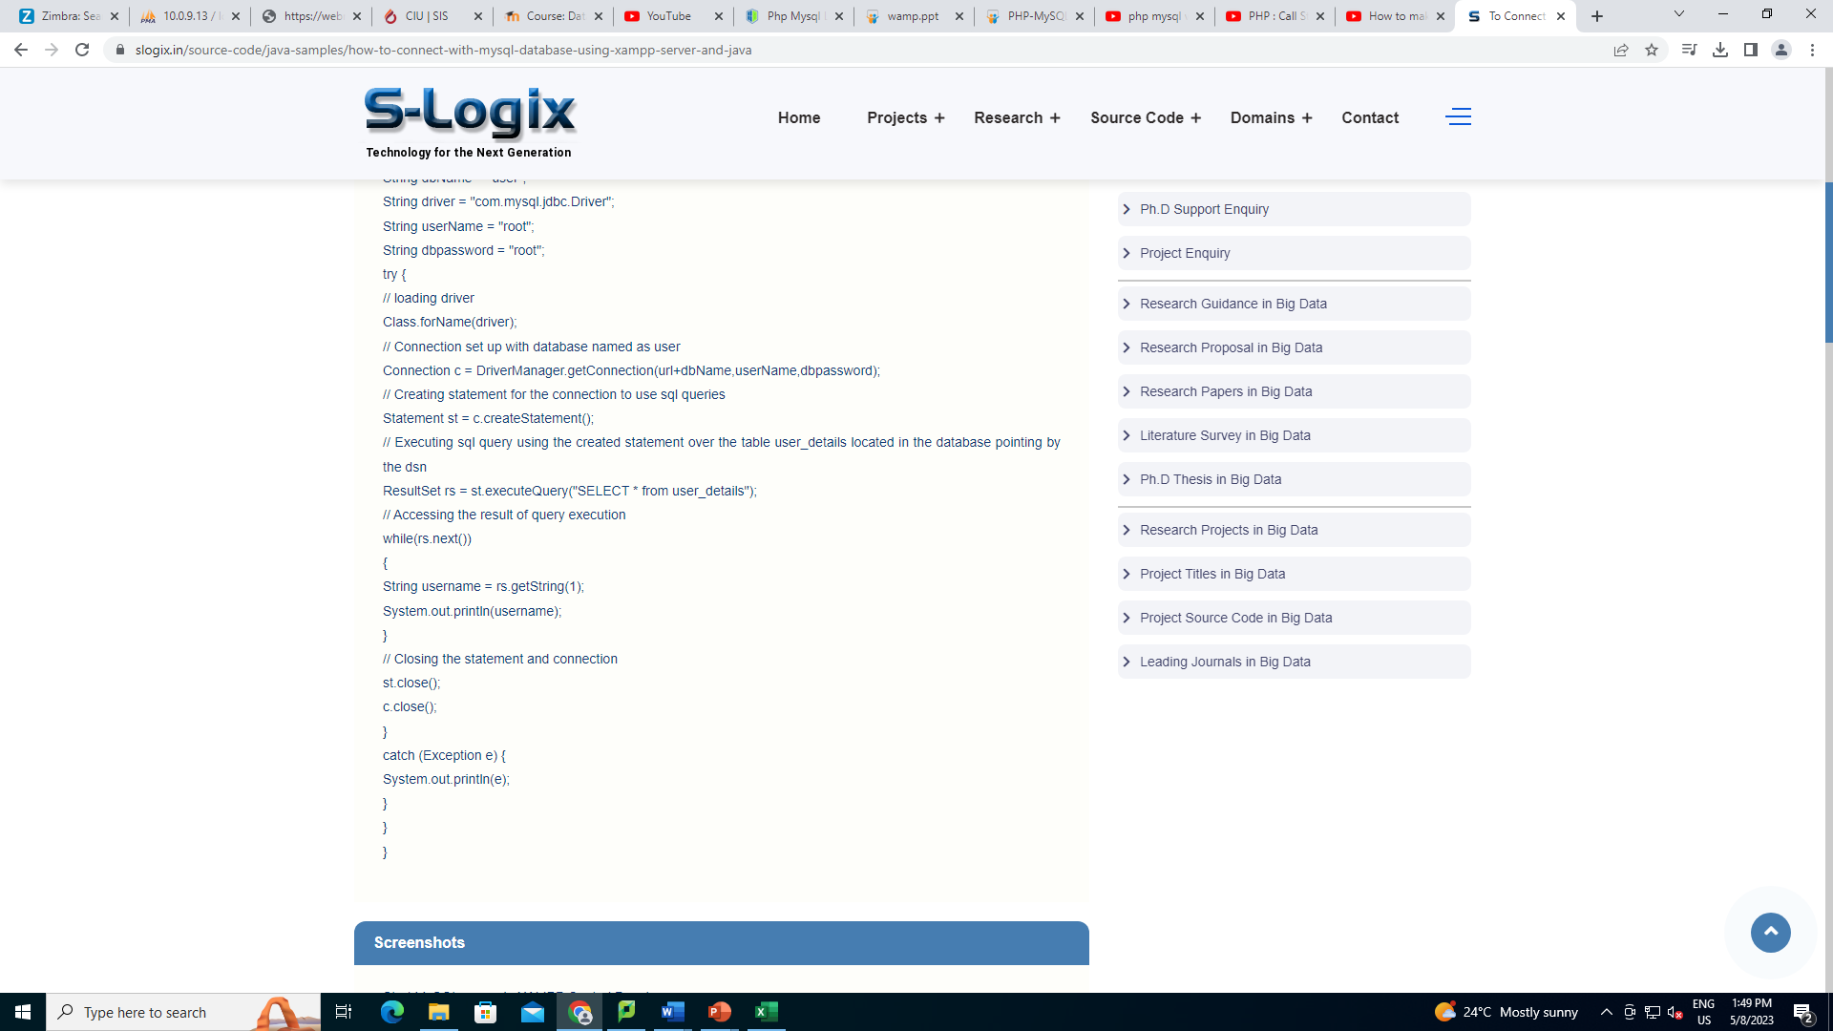
Connection Code

Slide 15
JDBC
JDBC is a Java API for communicating with database systems supporting SQL.
JDBC supports a variety of features for querying and updating data, and for retrieving query results.
JDBC also supports metadata retrieval, such as querying about relations present in the database and the names and types of relation attributes.
Model for communicating with the database:
Open a connection
Create a “statement” object
Execute queries using the statement object to send queries and fetch results
Exception mechanism to handle errors

Slide 16
JDBC Code
public static void JDBCexample(String dbid, String userid, String passwd)
{
try (Connection conn = DriverManager.getConnection( "jdbc:oracle:thin:@db.yale.edu:2000:univdb", userid, passwd);
Statement stmt = conn.createStatement(); )
{
… Do Actual Work ….
}
catch (SQLException sqle) {
System.out.println("SQLException : " + sqle);
}
}
NOTE: Above syntax works with Java 7, and JDBC 4 onwards. Resources opened in “try (….)” syntax (“try with resources”) are automatically closed at the end of the try block

Slide 17
JDBC SUBSECTIONS
Connecting to the Database
Shipping SQL Statements to the Database System
Exceptions and Resource Management
Retrieving the Result of a Query
Prepared Statements
Callable Statements
Metadata Features
Other Features
Database Access from Python

Slide 18
JDBC Code Details
Getting result fields:
rs.getString(“dept_name”) and rs.getString(1) equivalent if dept_name is the first argument of select result.
Dealing with Null values
int a = rs.getInt(“a”);
if (rs.wasNull()) Systems.out.println(“Got null value”);

Slide 19
Prepared Statement
PreparedStatement pStmt = conn.prepareStatement( "insert into instructor values(?,?,?,?)"); pStmt.setString(1, "88877"); pStmt.setString(2, "Perry"); pStmt.setString(3, "Finance"); pStmt.setInt(4, 125000); pStmt.executeUpdate(); pStmt.setString(1, "88878"); pStmt.executeUpdate();
WARNING: always use prepared statements when taking an input from the user and adding it to a query
NEVER create a query by concatenating strings
"insert into instructor values(' " + ID + " ', ' " + name + " ', " + " ' + dept name + " ', " ' balance + ')“
What if name is “D'Souza”?

Slide 20
SQL Injection
Suppose query is constructed using
"select * from instructor where name = '" + name + "'"
Suppose the user, instead of entering a name, enters:
X' or 'Y' = 'Y
then the resulting statement becomes:
"select * from instructor where name = '" + "X' or 'Y' = 'Y" + "'"
which is:
select * from instructor where name = 'X' or 'Y' = 'Y'
User could have even used
X'; update instructor set salary = salary + 10000; --
Prepared stament internally uses: "select * from instructor where name = 'X\' or \'Y\' = \'Y'
Always use prepared statements, with user inputs as parameters

Slide 21
Metadata Features
ResultSet metadata
E.g.after executing query to get a ResultSet rs:
ResultSetMetaData rsmd = rs.getMetaData();
for(int i = 1; i <= rsmd.getColumnCount(); i++) {
System.out.println(rsmd.getColumnName(i));
System.out.println(rsmd.getColumnTypeName(i));
}
How is this useful?

Slide 22
Metadata (Cont)
Database metadata
DatabaseMetaData dbmd = conn.getMetaData();
// Arguments to getColumns: Catalog, Schema-pattern, Table-pattern, // and Column-Pattern // Returns: One row for each column; row has a number of attributes // such as COLUMN_NAME, TYPE_NAME // The value null indicates all Catalogs/Schemas. // The value “” indicates current catalog/schema // The value “%” has the same meaning as SQL like clause
ResultSet rs = dbmd.getColumns(null, "univdb", "department", "%");
while( rs.next()) {
System.out.println(rs.getString("COLUMN_NAME"),
rs.getString("TYPE_NAME");
}

Slide 23
Metadata (Cont)
Database metadata
DatabaseMetaData dbmd = conn.getMetaData();
// Arguments to getTables: Catalog, Schema-pattern, Table-pattern, // and Table-Type // Returns: One row for each table; row has a number of attributes // such as TABLE_NAME, TABLE_CAT, TABLE_TYPE, .. // The value null indicates all Catalogs/Schemas. // The value “” indicates current catalog/schema // The value “%” has the same meaning as SQL like clause // The last attribute is an array of types of tables to return. // TABLE means only regular tables
ResultSet rs = dbmd.getTables (“”, "", “%", new String[] {“TABLES”});
while( rs.next()) {
System.out.println(rs.getString(“TABLE_NAME“));
}

Slide 24
Finding Primary Keys
DatabaseMetaData dmd = connection.getMetaData(); // Arguments below are: Catalog, Schema, and Table // The value “” for Catalog/Schema indicates current catalog/schema // The value null indicates all catalogs/schemas ResultSet rs = dmd.getPrimaryKeys(“”, “”, tableName); while(rs.next()){ // KEY_SEQ indicates the position of the attribute in // the primary key, which is required if a primary key has multiple // attributes System.out.println(rs.getString(“KEY_SEQ”), rs.getString("COLUMN_NAME"); }

Slide 25
Transaction Control in JDBC
By default, each SQL statement is treated as a separate transaction that is committed automatically
bad idea for transactions with multiple updates
Can turn off automatic commit on a connection
conn.setAutoCommit(false);
Transactions must then be committed or rolled back explicitly
conn.commit(); or
conn.rollback();
conn.setAutoCommit(true) turns on automatic commit.

Slide 26
Other JDBC Features – Calling functions and procedures
Calling functions and procedures
CallableStatement cStmt1 = conn.prepareCall("{? = call some function(?)}");
CallableStatement cStmt2 = conn.prepareCall("{call some procedure(?,?)}");
Handling large object types
getBlob() and getClob() that are similar to the getString() method, but return objects of type Blob and Clob, respectively
get data from these objects by getBytes()
associate an open stream with Java Blob or Clob object to update large objects
blob.setBlob(int parameterIndex, InputStream inputStream).

Slide 27
JDBC Resources
JDBC Basics Tutorial
https://docs.oracle.com/javase/tutorial/jdbc/index.html

Slide 28
Connection from C Languages to a DB using ODBC Connector

Slide 29
ODBC
Open DataBase Connectivity (ODBC) standard
standard for application program to communicate with a database server.
application program interface (API) to
open a connection with a database,
send queries and updates,
get back results.
Applications such as GUI, spreadsheets, etc. can use ODBC

Slide 30
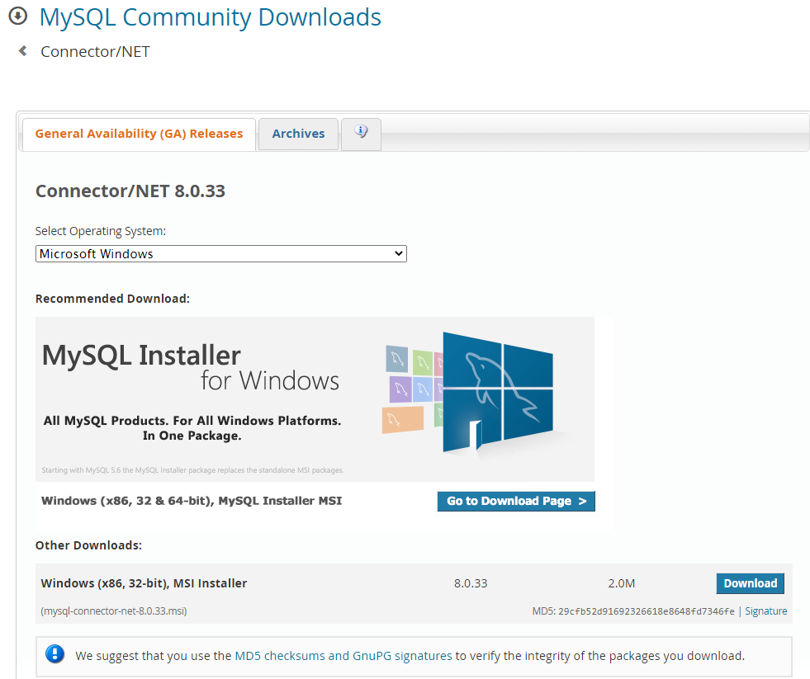
Download and Install MySQL .NET Connector Extension (Typical)

Slide 31
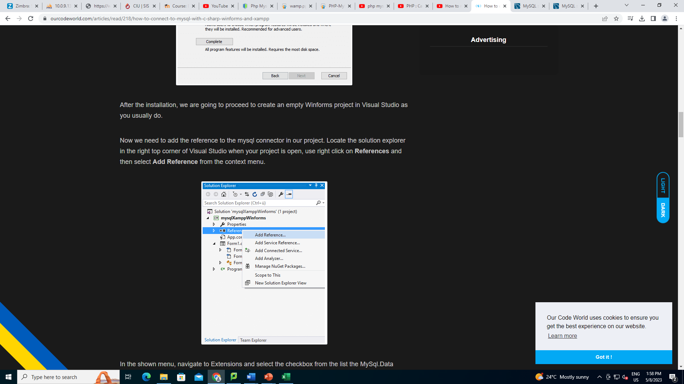
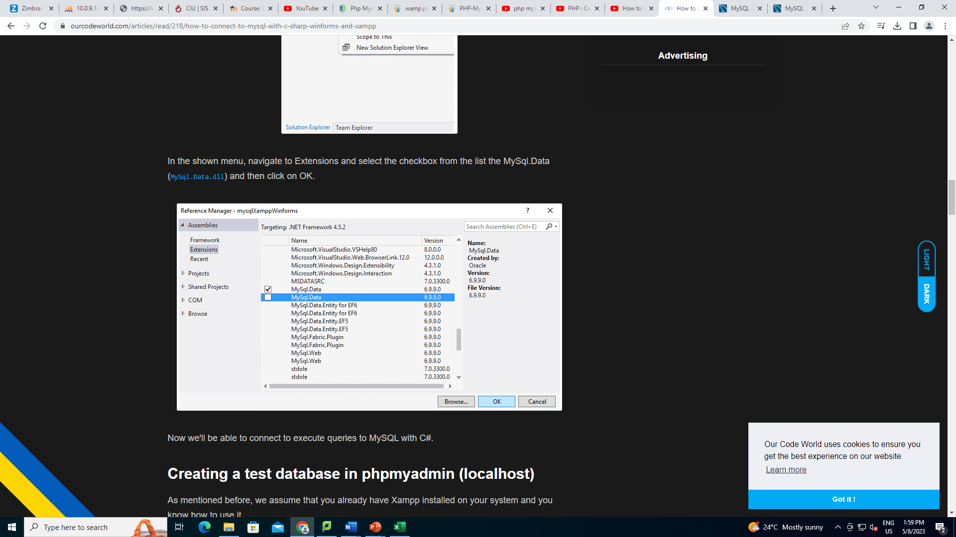
Add Reference to the Connector from Visual Studio (Select MySql.data)

Slide 32
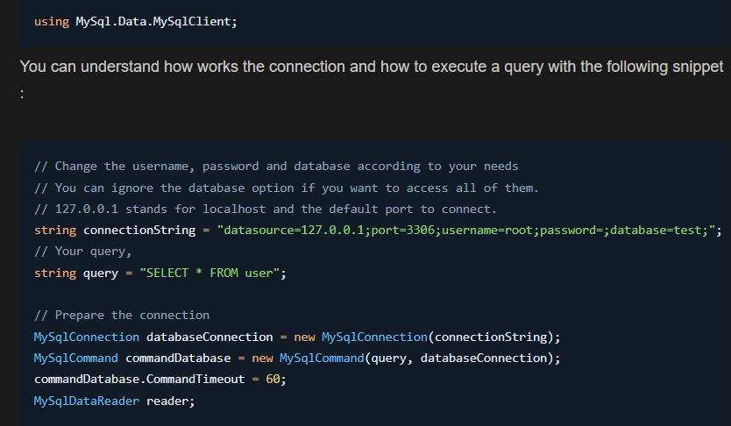
Connection from C# to Database

Slide 33
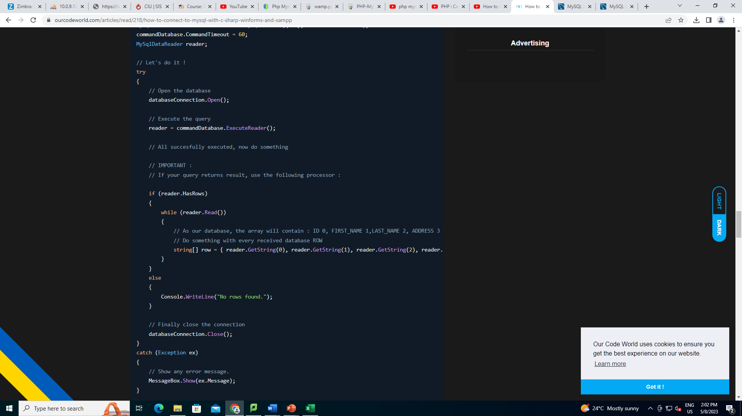

Slide 34
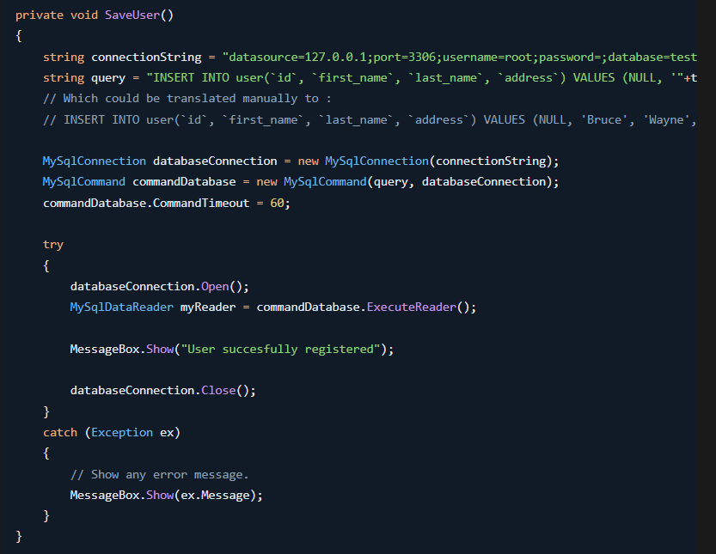
Inserting New Data

